Slide 1
K-Nearest Neighbor (KNN) Algorithm
K-Nearest Neighbors (KNN) is a simple way to classify things by looking at what's nearby. Imagine a streaming service wants to predict if a new user is likely to cancel their subscription (churn) based on their age. They checks the ages of its existing users and whether they churned or stayed. If most of the "K" closest users in age of new user canceled their subscription KNN will predict the new user might churn too. The key idea is that users with similar ages tend to have similar behaviors and KNN uses this closeness to make decisions.
Muhammad Saeed

Slide 2
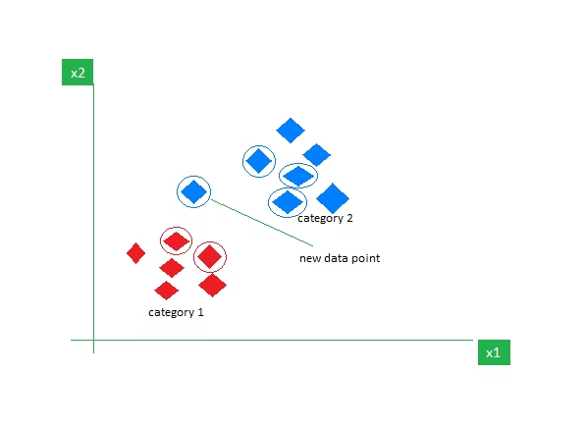
Getting Started with K-Nearest Neighbors
K-Nearest Neighbors is also called as a lazy learner algorithm because it does not learn from the training set immediately instead it stores the dataset and at the time of classification it performs an action on the dataset.
As an example, consider the following table of data points containing two features:
KNN Algorithm working visualization
The new point is classified as Category 2 because most of its closest neighbors are blue squares. KNN assigns the category based on the majority of nearby points.
The image shows how KNN predicts the category of a new data point based on its closest neighbours.
The red diamonds represent Category 1 and the blue squares represent Category 2.
The new data point checks its closest neighbours (circled points).
Since the majority of its closest neighbours are blue squares (Category 2) KNN predicts the new data point belongs to Category 2.
KNN works by using proximity and majority voting to make predictions.

Slide 3
What is 'K' in K Nearest Neighbour?
Definition of K
Example
In the k-Nearest Neighbours (k-NN) algorithm k is just a number that tells the algorithm how many nearby points (neighbours) to look at when it makes a decision.
Imagine you're deciding which fruit it is based on its shape and size. You compare it to fruits you already know.
If k = 3, the algorithm looks at the 3 closest fruits to the new one.
If 2 of those 3 fruits are apples and 1 is a banana, the algorithm says the new fruit is an apple because most of its neighbours are apples.

Slide 4
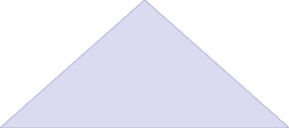
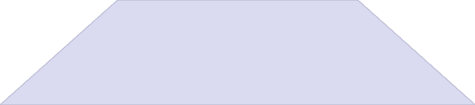
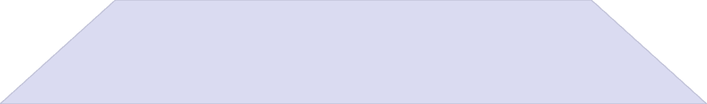
How to Choose the Value of K for KNN Algorithm
Optimal K Value
Balance between overfitting and underfitting
Statistical Methods
Cross-validation, Elbow method
Considerations
Noise, dataset size, odd values for k
The value of k is critical in KNN as it determines the number of neighbors to consider when making predictions. Selecting the optimal value of k depends on the characteristics of the input data. If the dataset has significant outliers or noise a higher k can help smooth out the predictions and reduce the influence of noisy data. However choosing very high value can lead to underfitting where the model becomes too simplistic.
Statistical Methods for Selecting k:
Cross-Validation: A robust method for selecting the best k is to perform k-fold cross-validation. This involves splitting the data into k subsets training the model on some subsets and testing it on the remaining ones and repeating this for each subset. The value of k that results in the highest average validation accuracy is usually the best choice.
Elbow Method: In the elbow method we plot the model's error rate or accuracy for different values of k. As we increase k the error usually decreases initially. However after a certain point the error rate starts to decrease more slowly. This point where the curve forms an "elbow" that point is considered as best k.
Odd Values for k: It's also recommended to choose an odd value for k especially in classification tasks to avoid ties when deciding the majority class.

Slide 5



Distance Metrics Used in KNN Algorithm
KNN uses distance metrics to identify nearest neighbour, these neighbours are used for classification and regression task. To identify nearest neighbour we use below distance metrics:
Euclidean Distance
Manhattan Distance
Minkowski Distance
Euclidean distance is defined as the straight-line distance between two points in a plane or space. You can think of it like the shortest path you would walk if you were to go directly from one point to another.
This is the total distance you would travel if you could only move along horizontal and vertical lines (like a grid or city streets). It's also called "taxicab distance" because a taxi can only drive along the grid-like streets of a city.
Minkowski distance is like a family of distances, which includes both Euclidean and Manhattan distances as special cases.

Slide 6
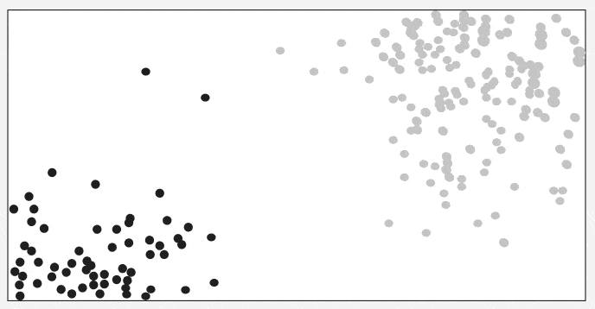
Working of KNN Algorithm
Thе K-Nearest Neighbors (KNN) algorithm operates on the principle of similarity where it predicts the label or value of a new data point by considering the labels or values of its K nearest neighbors in the training dataset.
Step 4: Voting for Classification or Taking Average for Regression
Step 3: Finding Nearest Neighbors
Step 2: Calculating distance
The k data points with the smallest distances to the target point are nearest neighbors.
When you want to classify a data point into a category (like spam or not spam), the K-NN algorithm looks at the K closest points in the dataset. These closest points are called neighbors. The algorithm then looks at which category the neighbors belong to and picks the one that appears the most. This is called majority voting.
Step 1: Selecting the optimal value of K
To measure the similarity between target and training data points Euclidean distance is used. Distance is calculated between data points in the dataset and target point.
K represents the number of nearest neighbors that needs to be considered while making prediction.
In regression, the algorithm still looks for the K closest points. But instead of voting for a class in classification, it takes the average of the values of those K neighbors. This average is the predicted value for the new point for the algorithm.
Working of KNN Algorithm
It shows how a test point is classified based on its nearest neighbors. As the test point moves the algorithm identifies the closest 'k' data points i.e 5 in this case and assigns test point the majority class label that is grey label class here.

Slide 7
Python Implementation of KNN Algorithm
1. Importing Libraries
import numpy as np from collections import Counter
Counter: is used to count the occurrences of elements in a list or iterable. In KNN after finding the k nearest neighbors labels Counter helps count how many times each label appears.
2. Defining the Euclidean Distance Function
def euclidean_distance(point1, point2): return np.sqrt(np.sum((np.array(point1) - np.array(point2))**2))
euclidean_distance: to calculate euclidean distance between points
3. KNN Prediction Function
def knn_predict(training_data, training_labels, test_point, k): distances = [] for i in range(len(training_data)): dist = euclidean_distance(test_point, training_data[i]) distances.append((dist, training_labels[i])) distances.sort(key=lambda x: x[0]) k_nearest_labels = [label for _, label in distances[:k]] return Counter(k_nearest_labels).most_common(1)[0][0]
4. Training Data, Labels and Test Point
training_data = [[1, 2], [2, 3], [3, 4], [6, 7], [7, 8]] training_labels = ['A', 'A', 'A', 'B', 'B'] test_point = [4, 5] k = 3
5. Prediction and Output
prediction = knn_predict(training_data, training_labels, test_point, k) print(prediction)
Output: A
The algorithm calculates the distances of the test point [4, 5] to all training points, selects the 3 closest points (as k = 3), and determines their labels. Since the majority of the closest points are labelled 'A', the test point is classified as 'A'.
In machine learning we can also use Scikit Learn python library which has in built functions to perform KNN machine learning model and for that you refer to Implementation of KNN classifier using Sklearn.

Slide 8
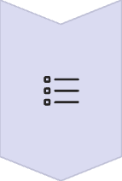
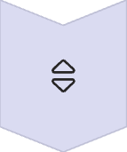
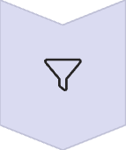
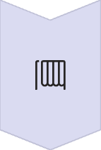
KNN Prediction Function Explained
distances.append
Each distance is paired with the corresponding label (training_labels[i]) of the training data. This pair is stored in a list called distances.
distances.sort
The list of distances is sorted in ascending order so that the closest points are at the beginning of the list.
k_nearest_labels
The function then selects the labels of the k closest neighbors.
Counter and most_common
The labels of the k nearest neighbors are counted using the Counter class, and the most frequent label is returned as the prediction for the test_point. This is based on the majority vote of the k neighbors.

Slide 9

Applications of the KNN Algorithm
Recommendation Systems
Spam Detection
Customer Segmentation
Speech Recognition
KNN is widely used in filtering spam emails. By comparing the features of a new email with those of previously labeled spam and non-spam emails, KNN can predict whether a new email is spam or not.
In marketing firms, KNN is used to segment customers based on their purchasing behavior. By comparing new customers to existing customers, KNN can easily group customers into segments with similar choices and preferences. This helps businesses target the right customers with right products or advertisements.
KNN is often used in speech recognition systems to transcribe spoken words into text. The algorithm compares the features of the spoken input with those of known speech patterns. It then predicts the most likely word or command based on the closest matches.
Many recommendation systems, such as those used by Netflix or Amazon, rely on KNN to suggest products or content. KNN observes at user behavior and finds similar users. If user A and user B have similar preferences, KNN might recommend movies that user A liked to user B.

Slide 10




Advantages of the KNN Algorithm
Easy to implement
No training required
The KNN algorithm is easy to implement because its complexity is relatively low as compared to other machine learning algorithms.
KNN stores all data in memory and doesn't require any training so when new data points are added it automatically adjusts and uses the new data for future predictions.
Few Hyperparameters
Flexible
The only parameters which are required in the training of a KNN algorithm are the value of k and the choice of the distance metric which we would like to choose from our evaluation metric.
It works for Classification problem like is this email spam or not?and also work for Regression task like predicting house prices based on nearby similar houses.

Slide 11



Disadvantages of the KNN Algorithm
Doesn't scale well
Curse of Dimensionality
Prone to Overfitting
KNN is considered as a "lazy" algorithm as it is very slow especially with large datasets
As the algorithm is affected due to the curse of dimensionality it is prone to the problem of overfitting as well.
When the number of features increases KNN struggles to classify data accurately a problem known as curse of dimensionality.

Slide 12
KNN for Classification vs Regression
Classification with KNN
Regression with KNN
In classification tasks, KNN predicts the class of a new data point by finding the most common class among its k nearest neighbors.
In regression tasks, KNN predicts a continuous value by averaging the values of its k nearest neighbors.
Uses mean or median of neighbor values
Uses majority voting to determine the class
Predicts numerical values rather than categories
Works well for multi-class problems
Output is a continuous value
Output is a discrete class label
Example: Predicting house prices based on features of similar houses in the neighborhood.
Example: Classifying emails as spam or not spam based on features like word frequency, sender information, etc.

Slide 13



Optimizing KNN Performance
Data Preprocessing
Normalize features to ensure equal contribution
Parameter Tuning
Find optimal k value and distance metric
Dimensionality Reduction
3
Apply PCA or feature selection to combat curse of dimensionality
Algorithm Optimization
Use KD-trees or ball trees for faster neighbor search
To improve KNN performance, start with proper data preprocessing including normalization to ensure all features contribute equally. Then tune parameters like k value and distance metrics through cross-validation. For high-dimensional data, apply dimensionality reduction techniques to combat the curse of dimensionality. Finally, implement algorithmic optimizations like KD-trees or ball trees to speed up the neighbor search process, especially for large datasets.

Slide 14
KNN vs Other Machine Learning Algorithms
Algorithm
Advantages
Disadvantages
Best Use Cases
KNN
Simple, no training phase, works with any number of classes
Slow with large datasets, sensitive to irrelevant features
Small to medium datasets with few features
Decision Trees
Easy to interpret, handles mixed data types
Can overfit, unstable with small variations in data
Categorical data, feature importance analysis
Random Forest
Robust to overfitting, handles large datasets
Black box model, computationally intensive
Complex datasets with many features
SVM
Effective in high dimensions, memory efficient
Difficult parameter tuning, slow training with large datasets
Text classification, image recognition
Neural Networks
Captures complex patterns, highly accurate
Requires large data, computationally expensive
Image/speech recognition, complex predictions

Slide 15
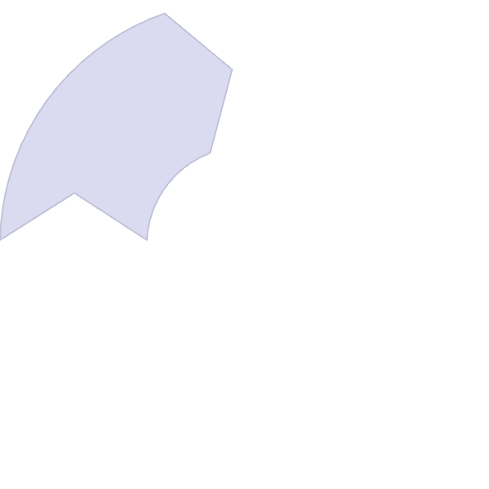
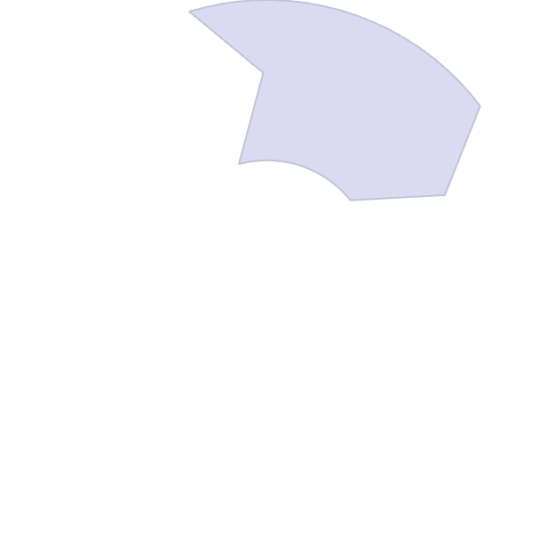
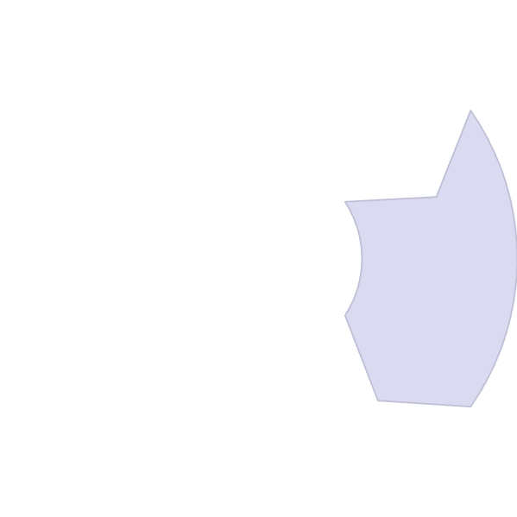
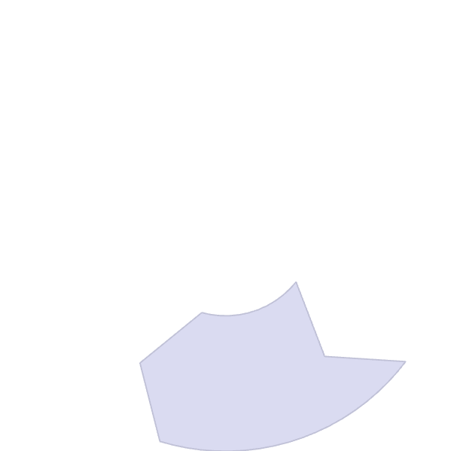
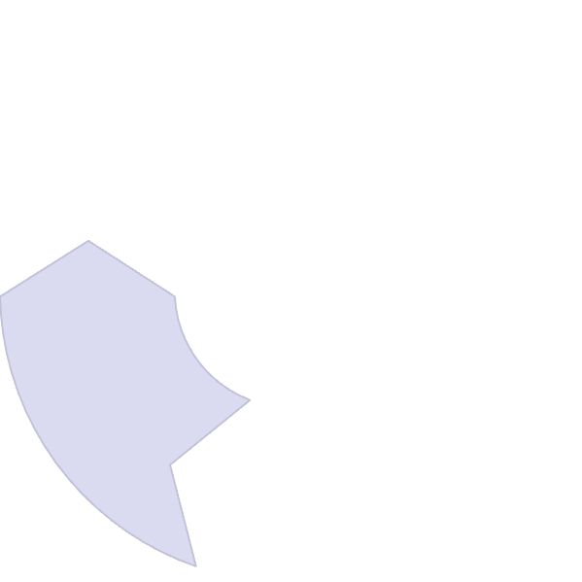





Summary: Key Points About KNN Algorithm
Key Parameters
Core Concept
The value of k and the choice of distance metric are critical for optimal performance
KNN classifies data points based on the majority class of their k nearest neighbors, using distance metrics to determine proximity
Strengths
Simple implementation, no training phase, works for both classification and regression
Applications
Recommendation systems, spam detection, customer segmentation, and speech recognition
Limitations
Computationally expensive for large datasets, sensitive to the curse of dimensionality

